Slide 1

File
Encryption
CREDIT INFORMATION CORPORATION

Slide 2
Submission Data File
Installing the Encryption Software
Install the Encryption Software (Kleopatra)
Once Gpg4win 2.2.4 is installed on your computer, you have to import the Public Key (CIC_TestEnv_PubKey.asc) provided by CIC. This import operation must be done only once.

Slide 3
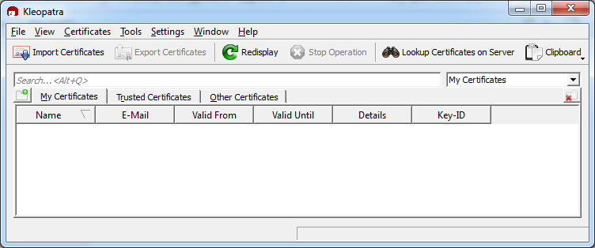
Submission Data File
Installing the Public Key
Open Kleopatra
2. Select “Import Certificates” and select the folder where you saved the file “CIC_TestEnv_PubKey.asc”

Slide 4
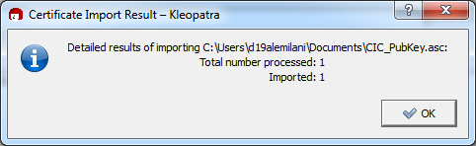
Submission Data File
Installing the Public Key
Select the Public Key provided by CIC and click Open
Click Ok. Now the certificate is imported.

Slide 5
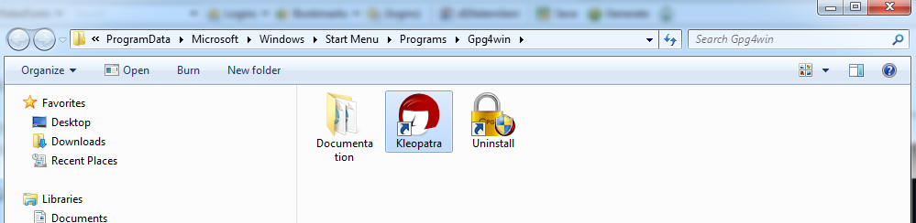
Submission Data File
How to Encrypt the Text File
(to be done every time a file is submitted)
Open Kleopatra tool

Slide 6
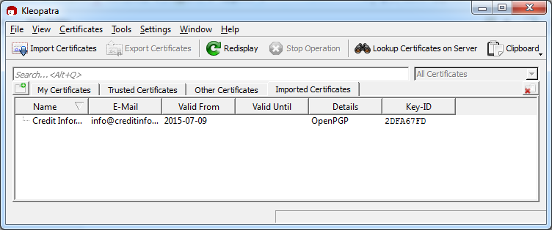
Submission Data File
How to Encrypt the Text File
(to be done every time a file is submitted)
The following page will open:

Slide 7
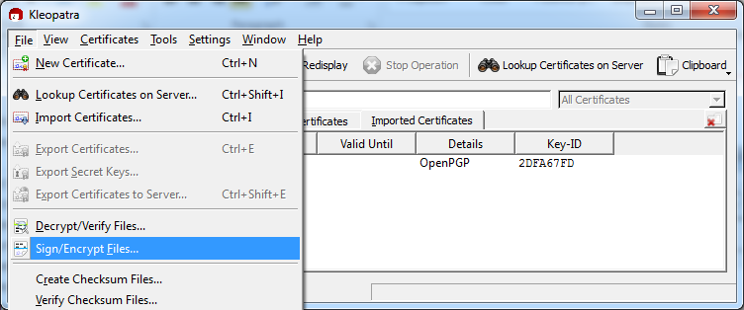
Submission Data File
Click on File -> Sign/Encrypt files

Slide 8
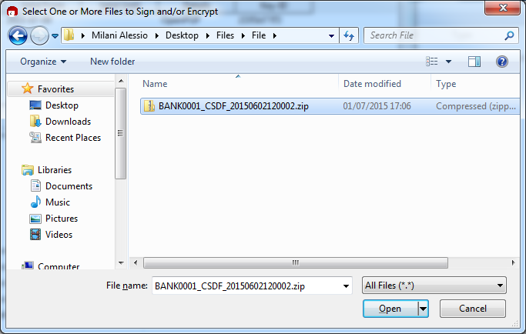
Submission Data File
Locate the file to encrypt
Select the file and Click Open

Slide 9
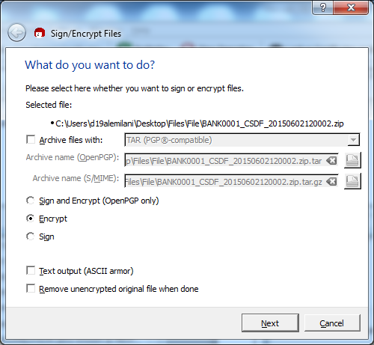
Submission Data File
Select radio button “Encrypt” and click Next

Slide 10
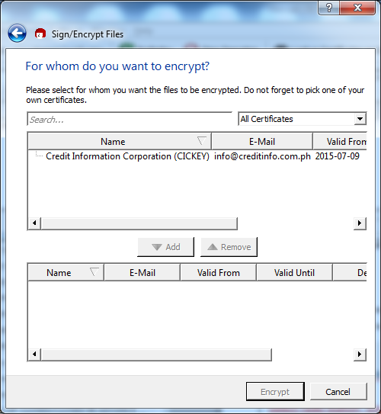
Submission Data File
Select the certificate to use and then click on Add

Slide 11
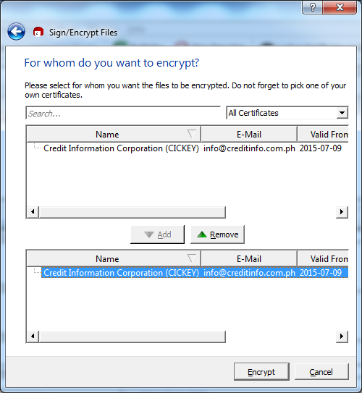
Submission Data File
The Certificate will appear at the lower side of the window

Slide 12
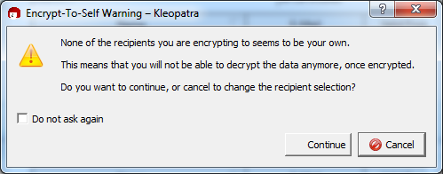
Submission Data File
Click on Encrypt
Click on Continue

Slide 13
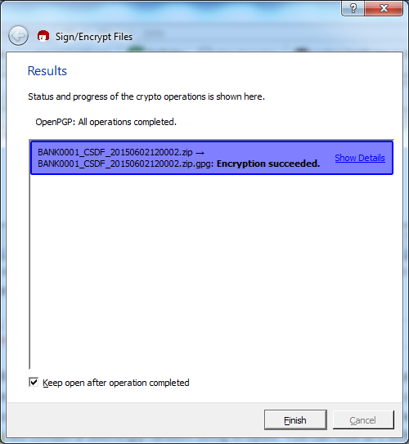
Submission Data File
Click on Finish
A file with extension .gpg will be created:
BANK0001_CSDF_20150602120002.zip.gpg

